Slide 1
Human Pose Estimation using DeepPose
Advancements in Deep Learning
Ishaan Abhyankar- 21d100008

Slide 2
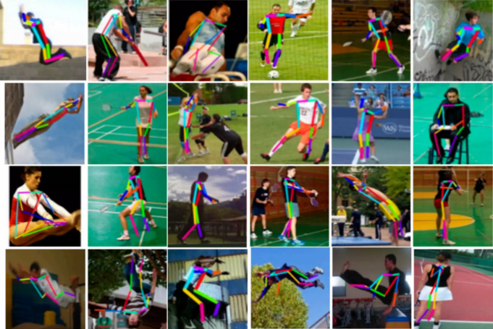
Problem Definition
Human Pose Estimation involves determining the positions of body joints in images or videos.
Challenges: Variability in poses, occlusions, and complex spatial relationships.

Slide 3
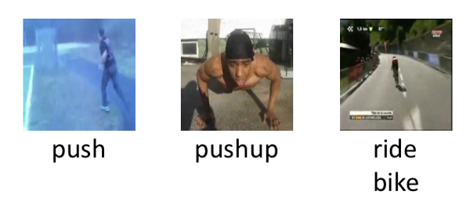
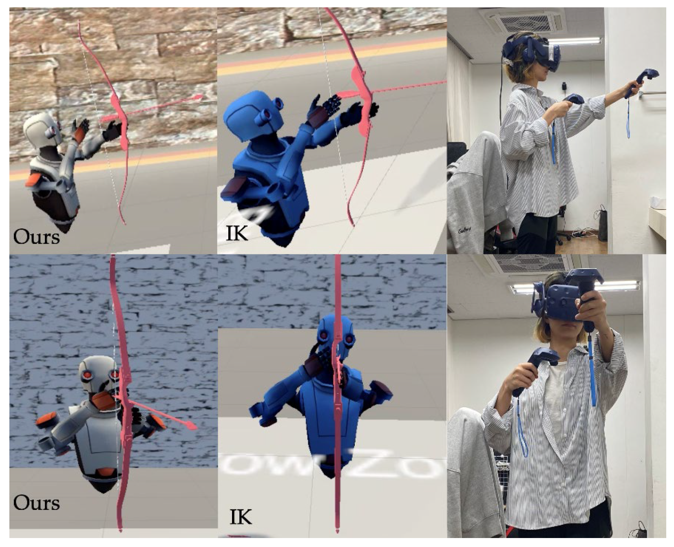
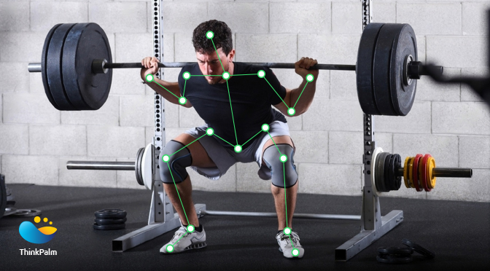
Applications
Action recognition
Virtual reality
Healthcare

Slide 4
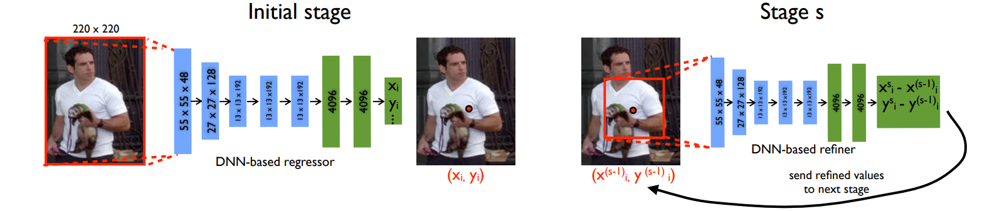
Overview of DeepPose
Network: ResNets
Optimizer: Adam
Regression: Utilizes heatmap regression for joint localization

Slide 5
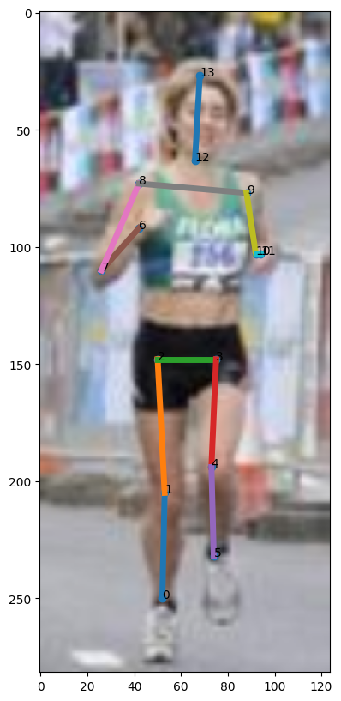
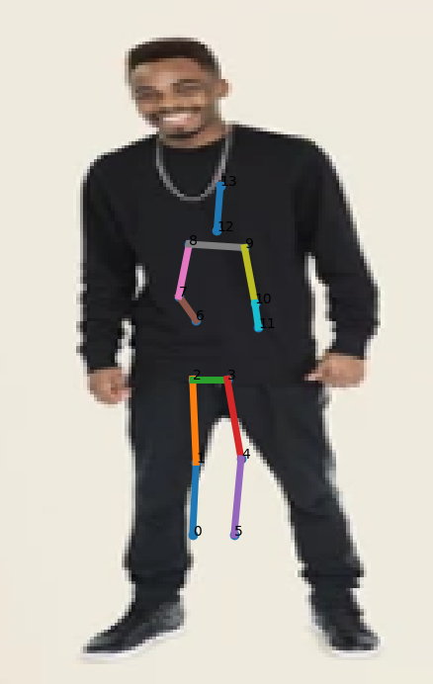
Results

Slide 6
THANK YOU

